Slide 1
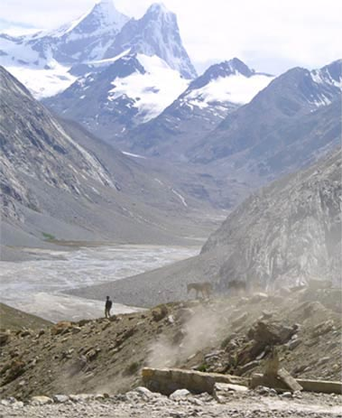
Fellowship of the Heart
Getting Started — the Four Connects, walked around the table on alternating evenings
Evening Series 2026–27 · at the Tittle home · v1.5E DRAFT
All Scripture: ESV · The Companion lesson plans carry the full scripts — these slides carry the room
1
Notes:
DECK TITLE · pre-session · DIVIDER
On screen as the room assembles on night one. All Scripture ESV; the plans carry the scripts; these slides carry the room — and these notes carry you.

Slide 2

SESSION 21
Sending and Blessing
Family commissioning, the integration of the four Connects, and the bridge to Going Deeper
Quarter 4: Consolidation & Sending
256
Notes:
S21 · pre-session · DIVIDER
On screen through dinner and as the circle forms. Greet at the door — the slide holds the room. TONIGHT MAY RUN LONG: the school version is 120 minutes (food 4:00, session 4:15–6:15); the evening shape · standard 7:00–8:30 or a special longer evening · is decided at the lab. Visiting family without the twenty weeks of context get a warm brief at the door and a familiar Companion beside them. Survey return bin visible at the door.

Slide 3

Session 21 — Tonight’s Road
1 Welcome and integration teaching
2 Brief blessing rehearsal
3 Reading and prayer
4 Family commissionings
5 Final reflection circle
6 Rhythm Card and Going Deeper bridge
7 The Leader Feedback Round — both leaders
8 Final blessing and sending
257
Notes:
S21 · 7:00–8:30 · LEAD: BOTH LEADERS CIRCLE
BEATS:
1. Name the night: the Family Commissioning — a 120-minute night, extended on purpose; everything serves the hour in the middle.
2. Shape: integration teaching, blessing rehearsal, reading and prayer, the family commissionings (~55 min, the heart), reflection circle, Rhythm Card and Going Deeper bridge, feedback (droppable today), final blessing.
3. Hold the schedule — the time-keeper has real authority; 120 minutes must not become 150; the closing matters more than running long.
GUARD: Every absent-parent situation was pre-planned with the family — stand-in, cohort standing, or community blessing only. Decided in advance, never improvised on the night.

Slide 4
Welcome and Integration Teaching
• Fourteen Wednesdays — the soil of the heart, our stories, confession and restoration, hearing God in scripture, the gardens of our hearts, the quiet doubts, what was prepared for us
• Tonight is the integration. The four Connects are not separate disciplines — they are a sequence: Self, Others, God, Mission. Each one creates the conditions for the next.
• They are also a way of life — lived in family, witnessed in community
• Tonight: each parent-and-teen pair stands in the center; each speaks a specific witnessed blessing over the other; the whole community speaks the Aaronic blessing over each family
• If you are new tonight: your job is to bear witness. Your presence is the gift.
258
Notes:
S21 · 7:00–7:08 · LEAD: CONTAINER HOLDER CIRCLE
BEATS:
1. Welcome the new alongside the old — 'find a seat with your family' — and speak the Aaronic blessing over the room first, as every week.
2. Walk the year in one paragraph: the four Connects — Self, Others, God, Mission — a sequence and a way of life, done piece by piece across twenty evenings.
3. Name today's specific act: each parent-and-teen pair stands center; each speaks a specific witnessed blessing over the other; the community seals each family with the Aaronic blessing.
4. To the visitors: you may not have words for what was done here — that is fine; your presence is the gift; today you bear witness.

Slide 5
Brief Blessing Rehearsal — the Form
• Three sentences. Just three. The worksheet you got Friday has the form.
1 “What I have specifically seen God doing in you across Getting Started is _____.” Something you actually noticed.
2 “What I bless in you tonight is _____.” Something true about who they are.
3 “What I commit to you in our relationship moving forward is _____.” Something you will actually do.
• The brevity is the discipline — we are not making speeches; we are speaking truth in front of witnesses
• Two Companions demo a real blessing, then brief questions
259
Notes:
S21 · 7:25–7:31 · LEAD: CONTENT PRESENTER CIRCLE
BEATS:
1. Walk the three-sentence form aloud: what I have specifically seen God doing in you; what I bless in you today; what I commit to you moving forward.
2. Two Companions demo a real blessing — brief, specific, honest, never theatrical; the parents calibrate against this demo.
3. Brief Q&A, one or two questions; do not over-explain — the worksheet and the demo already taught it. Trust the room.
CUES: Blessing form = one specific witnessed sentence per line, not a speech — the brevity is the discipline; say it twice before the commissionings begin.
SUB: The demo blessing must be the speakers' own — real words about a real person they know. A covering leader never performs a borrowed blessing; if you are new to this room, demo with a Companion you genuinely know, or let two leadsanions carry the demo.

Slide 6
Reading and Prayer
• Two scriptures before we begin — the blessing itself, and what we are commissioning each other into
• The Aaronic blessing is not a generic prayer — it is the specific words God gave Aaron and his sons to speak over Israel. When we speak it over each other, we are not improvising.
• Philippians 1:6 — Getting Started is not the completion; it is part of the beginning. The next stretch is a longer work that is His to finish, not ours.
– “And I am sure of this, that he who began a good work in you will bring it to completion at the day of Jesus Christ.” — Philippians 1:6
• Then prayer over the commissioning to come
NUMBERS 6:24–26
“The Lord bless you and keep you;
the Lord make his face to shine upon you and be gracious to you;
the Lord lift up his countenance upon you and give you peace.”
260
Notes:
S21 · 7:31–7:37 · LEAD: CONTENT PRESENTER CIRCLE
BEATS:
1. Read Numbers 6:24–26, then Philippians 1:6, from the physical Bible.
2. Two framings, 90 seconds total: the Aaronic blessing is covenantal — the words God specifically authorized, not improvisation; and Getting Started is part of the beginning — the work is His to finish.
3. Pray over the commissioning to come, then move — the families are ready.

Slide 7
Family Commissionings
• Each family in turn — parent and teen stand in the center; the rest of the family stands behind them in support
1 Brief framing — “We have walked with [name] through Getting Started; we have seen _____.”
2 Teen blesses parent first — the three sentences
3 Parent blesses teen — the three sentences
4 “Family of [last name], the community now blesses you.” The whole room speaks the Aaronic blessing aloud together, slowly.
• If you freeze — take your time, or ask the other person to read your worksheet for you. If you cry, that is fine. The room can wait.
261
Notes:
S21 · 7:00–8:30 · LEAD: BOTH LEADERS CIRCLE
BEATS:
1. Per family (~5–7 min): call them center, family standing behind; ONE framing sentence per member; teen blesses parent FIRST; parent blesses teen; the room speaks the Aaronic over them; 30 seconds of breath between families.
2. Running long? Compress the framing — never the blessings.
3. A frozen teen: 'Take your time — or your mom can read it for you.' An overwhelmed parent: wait; most recover; if not, name the worksheet's heart with permission.
CUES: Blessing form = one specific witnessed sentence per line, not a speech.
GUARD: Absent-parent plans were pre-decided — stick to them. Real conflict surfacing: stop, step aside with the family, no interpreting in the room; Section 6, backup within the hour.
SUB: The framing must be witnessed truth — speak the team's prepared line per family (Run Card) as theirs; never invent a witness you did not see.

Slide 8
Final Reflection Circle
• Around the circle, each person: one specific takeaway from Getting Started, and one specific next commitment — about thirty seconds each
– The takeaway can be small — “I learned that I can name a doubt without losing my faith.” “I learned that my dad sees me.”
– The commitment can be small too — “I will keep the morning question.” “I will tell my mom one true thing this week.”
• You can pass. Visiting family can pass — or share if you want to. The leadsanions go first; a parent opens for the families.
262
Notes:
S21 · 8:07–8:13 · LEAD: CONTENT PRESENTER CIRCLE
BEATS:
1. Around the circle: one specific takeaway, one specific next commitment — about thirty seconds each, brisk. Small counts: 'I will keep the morning question' is a real commitment.
2. leadsanions go first to model; then the arranged parent opens for the families (Run Card) — never a cold call on a teen; pass-anytime holds; visitors may pass or share.
3. Receive without commentary — eye contact, slight nod; do not summarize anyone's sentence.

Slide 9
Rhythm Card and Going Deeper Bridge
1 The Daily / Weekly / Monthly Rhythm Card — daily: the morning question and an evening journal note; weekly: one person who knows what you are working on; monthly: a clearing time. It is your card, in your handwriting.
2 The Going Deeper bridge — twelve Wednesdays. Decide on your own time. Tonight is not a recruiting pitch.
3 The Post-Series Survey — the bin at the door tonight, or email it this week. The next group of families benefits from your honesty.
• If a daily practice slips — do not start over from scratch; start the next day. Streaks are not the point. Returning is the point.
263
Notes:
S21 · 8:13–8:19 · LEAD: CONTENT PRESENTER CIRCLE
BEATS:
1. Three practical things, warm and brief: the Daily/Weekly/Monthly Rhythm Card (H21.3 is a fresh copy — it is their card, in their handwriting); the Going Deeper bridge (H21.4 — dates, details, registration; decide on your own time); the Post-Series Survey — bin at the door today, or email this week.
2. Today is a sending, not a recruiting pitch — some families will continue, some will not, and both are good. Say it plainly and leave it there.

Slide 10
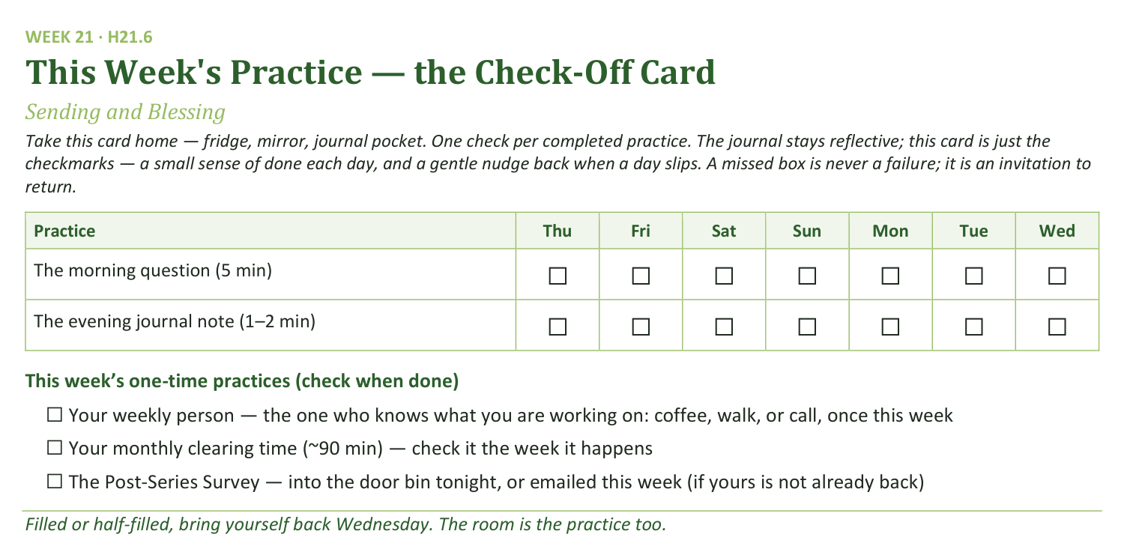
Your Take-Home Card — This Session’s Practice
Handed out now — fridge, mirror, journal pocket.
264
Notes:
S21 · 8:13–8:19 · LEAD: CONTENT PRESENTER CIRCLE
BEATS:
1. Check-off card H21.6: the morning question (5 min) and the session journal note (1–2 min), daily through the interlude.
2. One-time boxes: the weekly person who knows what you are working on; the monthly clearing time; the survey if not already back.
3. A missed box is never a failure; it is an invitation to return — streaks are not the point, returning is.

Slide 11
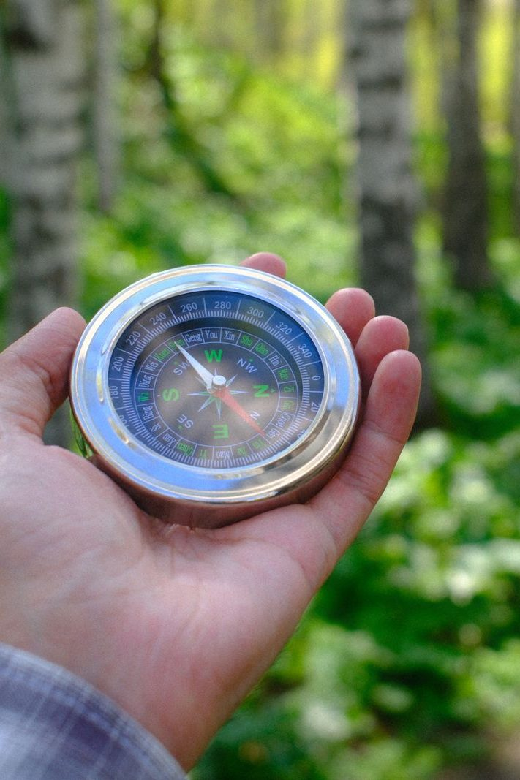
The Leader Feedback Round
• Two rounds, same as every session — the container holder first, then the content presenter: three things each
– “What I think went well tonight: ______”
– “What I’d do differently next time: ______”
– “If I were to teach tonight’s process to someone, I would tell them: ______”
• Then the room — the same two questions about tonight
• The leaders receive without defending — “thank you” is the whole response
265
Notes:
S21 · 8:24–8:28 · LEAD: BOTH LEADERS CIRCLE
BEATS:
1. Feedback round, standard shape — the leader's three answers, then the room, received undefended. On a commissioning night it may well be dropped: the ceremony is often the something-else the energy needs; dropping it twice running goes to the debrief.
2. Final blessing (6:10): the whole community speaks the Aaronic over the whole community — hands up, together, slowly. Pause; let the silence land.
3. 'You are sent. Walk gently.' Then announce Week 22 — the commissioning of the Companions; it is their night, and everyone is wanted in the room for it.
4. After the sending, do not pack up. Stay — some will not leave for an hour; the work after the closing is sometimes the work.

